Slide 1
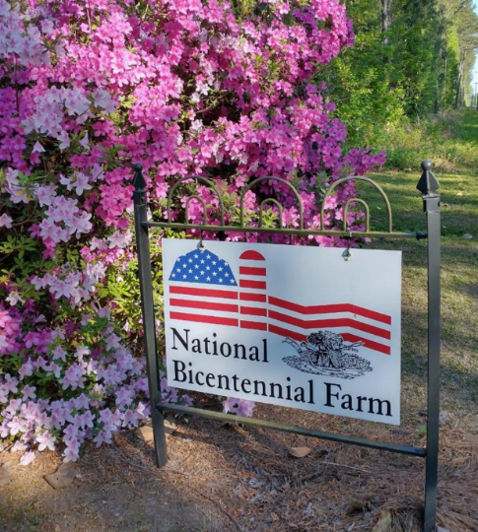
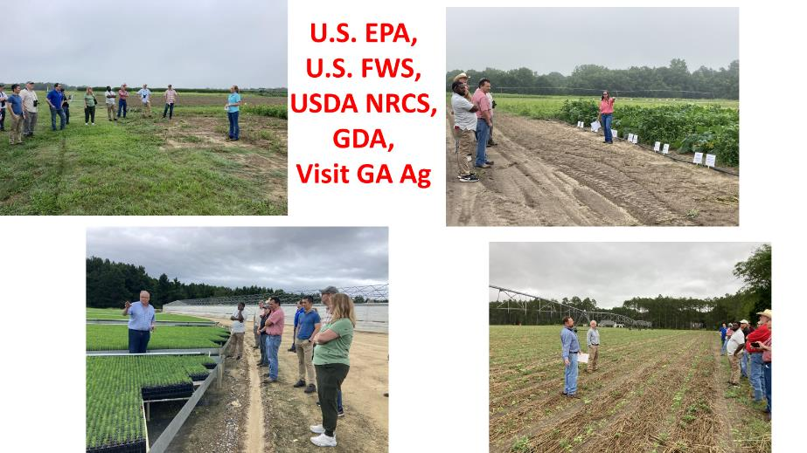
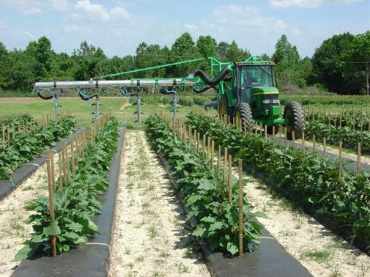
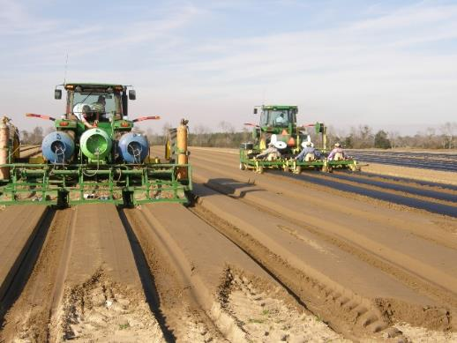
Vegetable Update 2025 – Weed Management
1772
Woodland, NC
Stanley Culpepper and Jenna Vance
Taylor Randell-Singleton, Hannah Wright-Smith, Camp Hand
University of Georgia
Tifton, GA

Slide 2
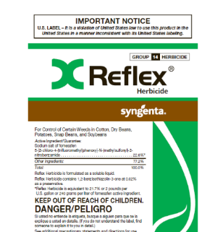




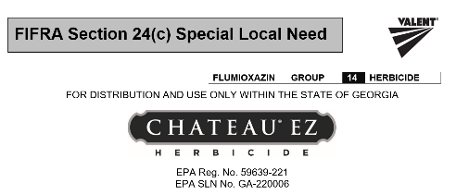
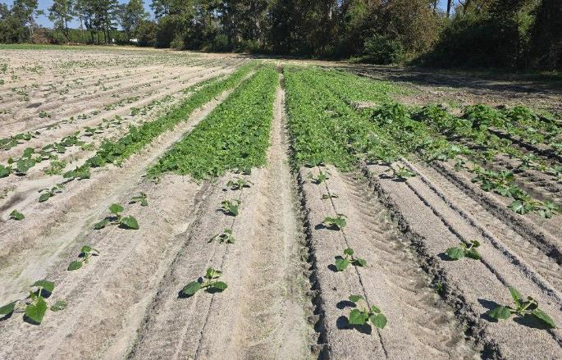
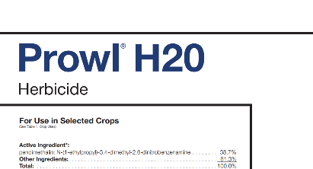
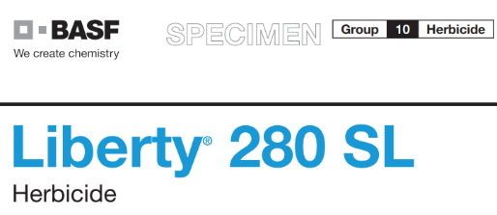
Lots of Impact from New Labels in Recent Years

Slide 3
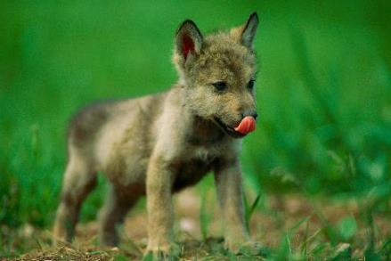
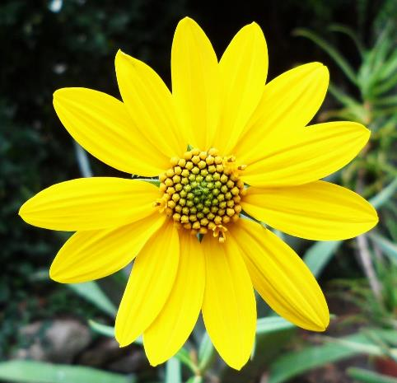
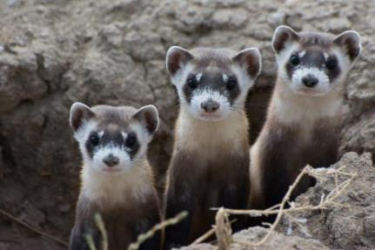
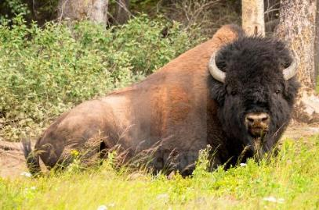
The Endangered Species Act (ESA)
ESA implemented in 1973
Provides framework to conserve & protect endangered & threatened species & their habitats!
Grey Wolf
Whorled Sunflower
Black-footed Ferret
Total of ~1600 species + 900 critical habitats!!!
Wood Bison

Slide 4
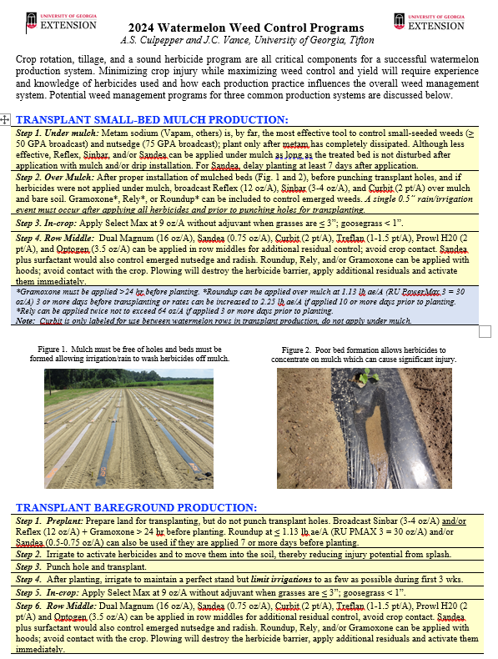
Very Minor Changes in Circulars
Cole crop
Leafy greens
Summer squash
Sweet potato
Watermelon
Are there others crops you would like programs for?

Slide 5
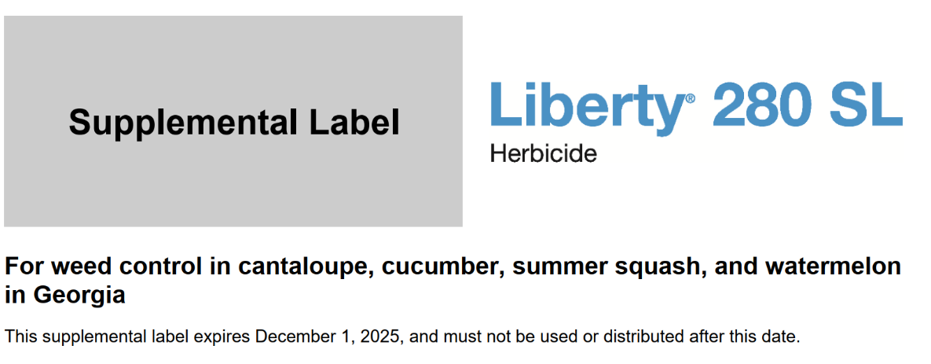
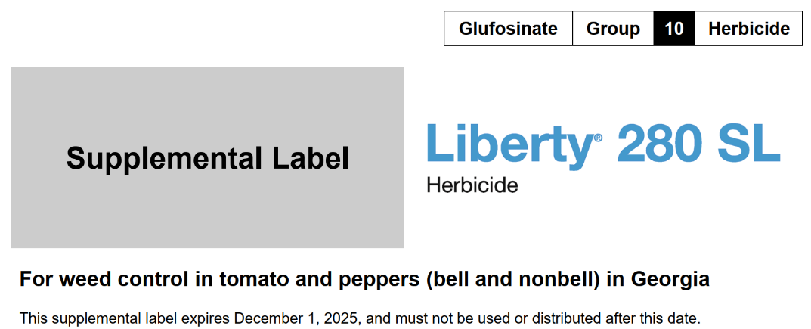
Rely Being Discontinued – Fortunate to Move to Liberty
Cantaloupe
Cucumber
Squash
Watermelon
Tomato
Pepper

Slide 6
Weed Response to Roundup, Liberty, and Mixtures.
% Large Crabgrass Control
100 a
100 a
86 b
53 c
RU followed by Liberty
Roundup
Liberty
Liberty+RU
% Goosegrass Control
100 a
100 a
78 b
53 c
RU followed by Liberty
Roundup
Liberty
Liberty+RU
Roundup PMAX 3 = full rate; Liberty = full rate. Goosegrass 6”; purslane 15”, crabgrass 8”. Veg 5-2024. Research conducted with Josh Dawson

Slide 7
Weed Response to Roundup, Liberty, and Mixtures.
% Pink Purslane Control
97 a
100 a
78 b
68 c
RU followed by Liberty
Roundup
Liberty
Liberty+RU
% Ragweed Parthenium
98 ab
100 a
92 b
15 c
RU followed by Liberty
Roundup
Liberty
Liberty+RU
Roundup PMAX 3 = full rate; Liberty = full rate. Goosegrass 6”; purslane 15”, crabgrass 8”. Veg 5-2024. Research conducted with Josh Dawson

Slide 8
Weed Response to Roundup, Liberty, and Mixtures.
% Wild Radish Control
98 a
100 a
54 b
34 c
RU followed by Liberty
Roundup
Liberty
Liberty+RU
Roundup PMAX 3 = full rate; Liberty = full rate. Radish 5”.

Slide 9
Limiting antagonism from POST tank mixtures
Smaller weed sizes, usually less than few inches
Residual herbicides reducing density and size
Full herbicide rates
Coverage essential
Sequential applications is the best option, especially during burndown

Slide 10
Chateau EZ 24(c) Indemnified Labels For Raised Bed Mulch Row Middle
Fruiting Veg: eggplant, groundcherry, okra, pepino, bell pepper, chili pepper, cooking pepper, pimento, sweet pepper, tomatillo, tomato
Cucurbits: chayote, Chinese waxgourd, citron melon, cucumber, gherkin, gourd, edible (hyotan, cucuzza, hechima, Chinese okra), momordica (balsam apple/pear, bittermelon, Chinese cucumber, cantaloupe, pumpkin, summer squash, winter squash (butternut, calabaza, hubbard, acorn, spaghetti), watermelon
Brassica: Broccoli, brussels sprouts, cabbage, Chinese cabbage, napa cabbage, cauliflower
> 42 crops

Slide 11
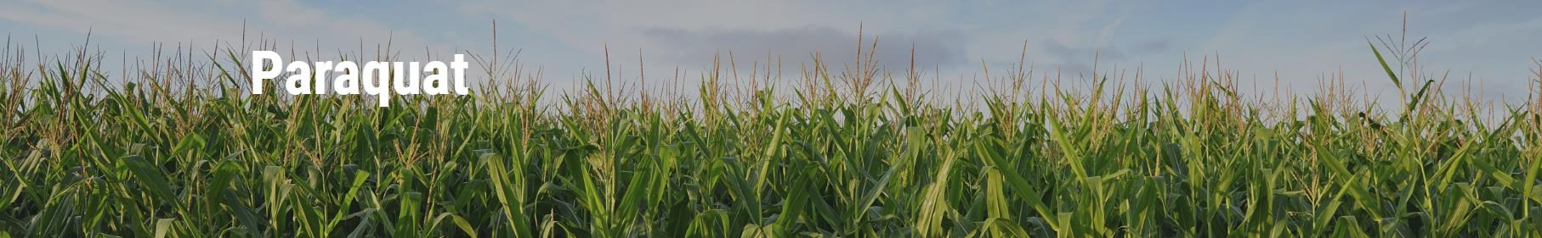
The paraquat training module is now live on Syngenta’s website. It is available at Paraquat Training. Links from Gramoxone 2.0 and 3.0 pages have been updated along with the EPA paraquat page.
No charge for the training
English and Spanish
One time registration form requiring name, email address, state, and pesticide application license number.
Automatic renewal email

Slide 12

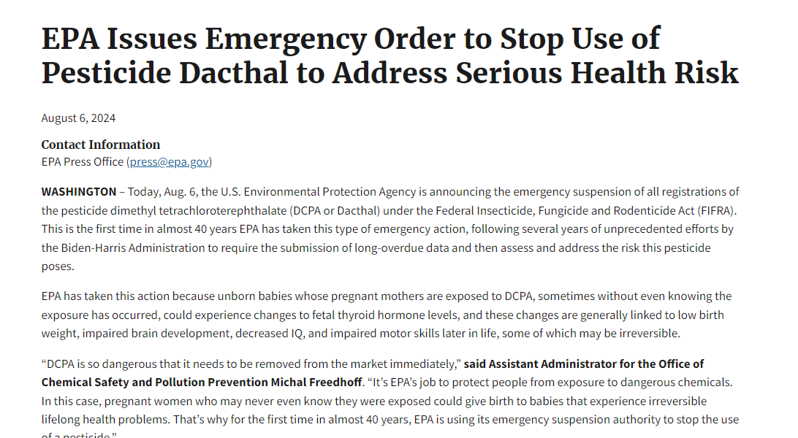

Slide 13
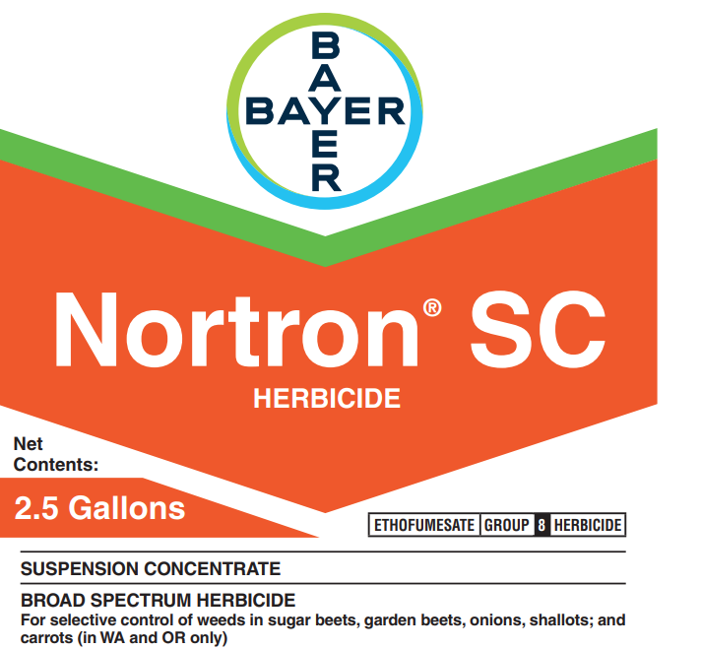
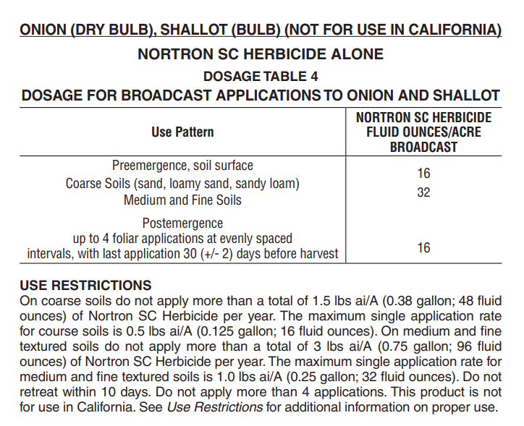
Search for Dacthal Alternatives in Seeded Onion

Slide 14
2024/2025 Onion Plots and Vidalia Onion Research Farm

Slide 15
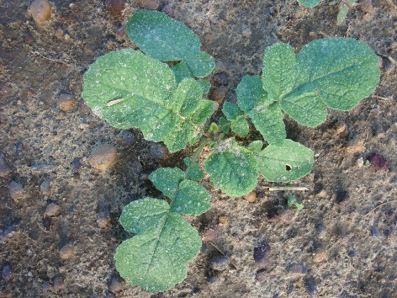
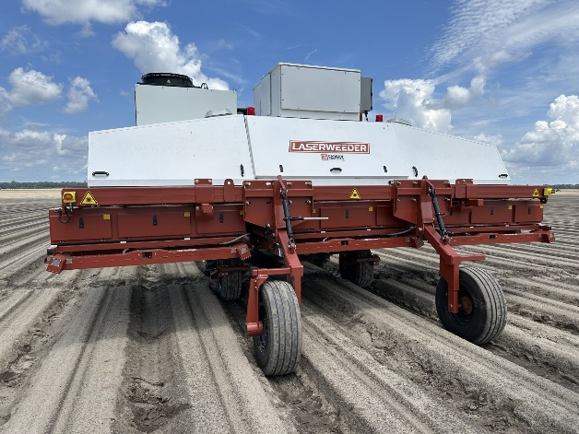
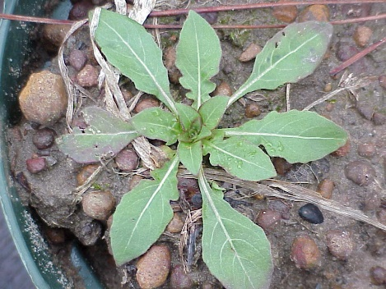
Efforts in Seeded Onions
We continue our search…any ideas?
LaserWeeder
Notes:
Good even

Slide 16
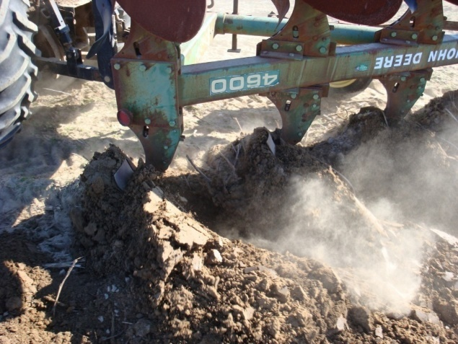

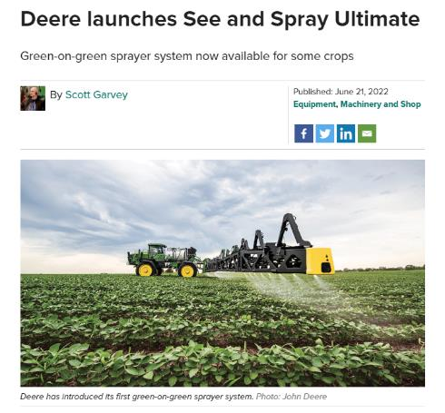
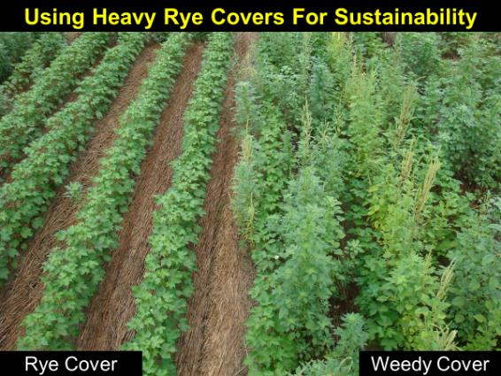
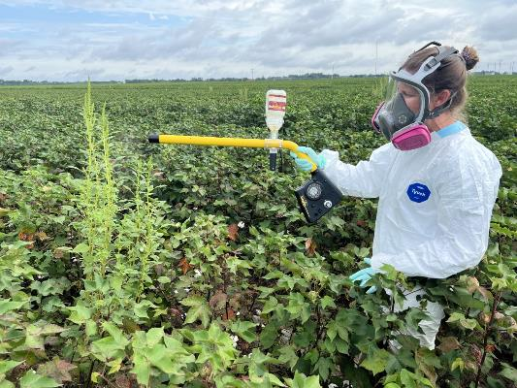
DEEP TILLAGE
Laser Weeder
Lynn Sosnoskie
SEE AND SPRAY TECHNOLOGY
Deep Tillage
WeedOut pollen
Cover
Crops

Slide 17
Seeded Onion Treatments – Planted Oct 23
1. No weed control
2. LaserWeeder Nov 9, Nov 21, Dec 5, Jan 3
3. Herbicide program
4. Herbicide program + LaserWeeder
Herbicide Program
Dacthal 3 pt PRE
Dacthal 3 pt Flag
Prowl 2 pt 2 lf
Goal 4 F 0.75 oz 2 lf
Goal 4 F 0.75 oz 3 lf
Goal 4 F 8 oz 6 leaf
Prowl 12 oz 6 leaf
Notes:
Good even

Slide 18
Percent Primrose Control (Seeded Onion)
Harvest – May 3
# primrose/A: none = 71K; herbicide: 22.8K; LW: 816; LW + Herb: 181
93 a
90 a
%
11 b
0 c
No herbicide
Full Herbicide program
LaserWeeder Alone
LaserWeeder + Herbicide

Slide 19
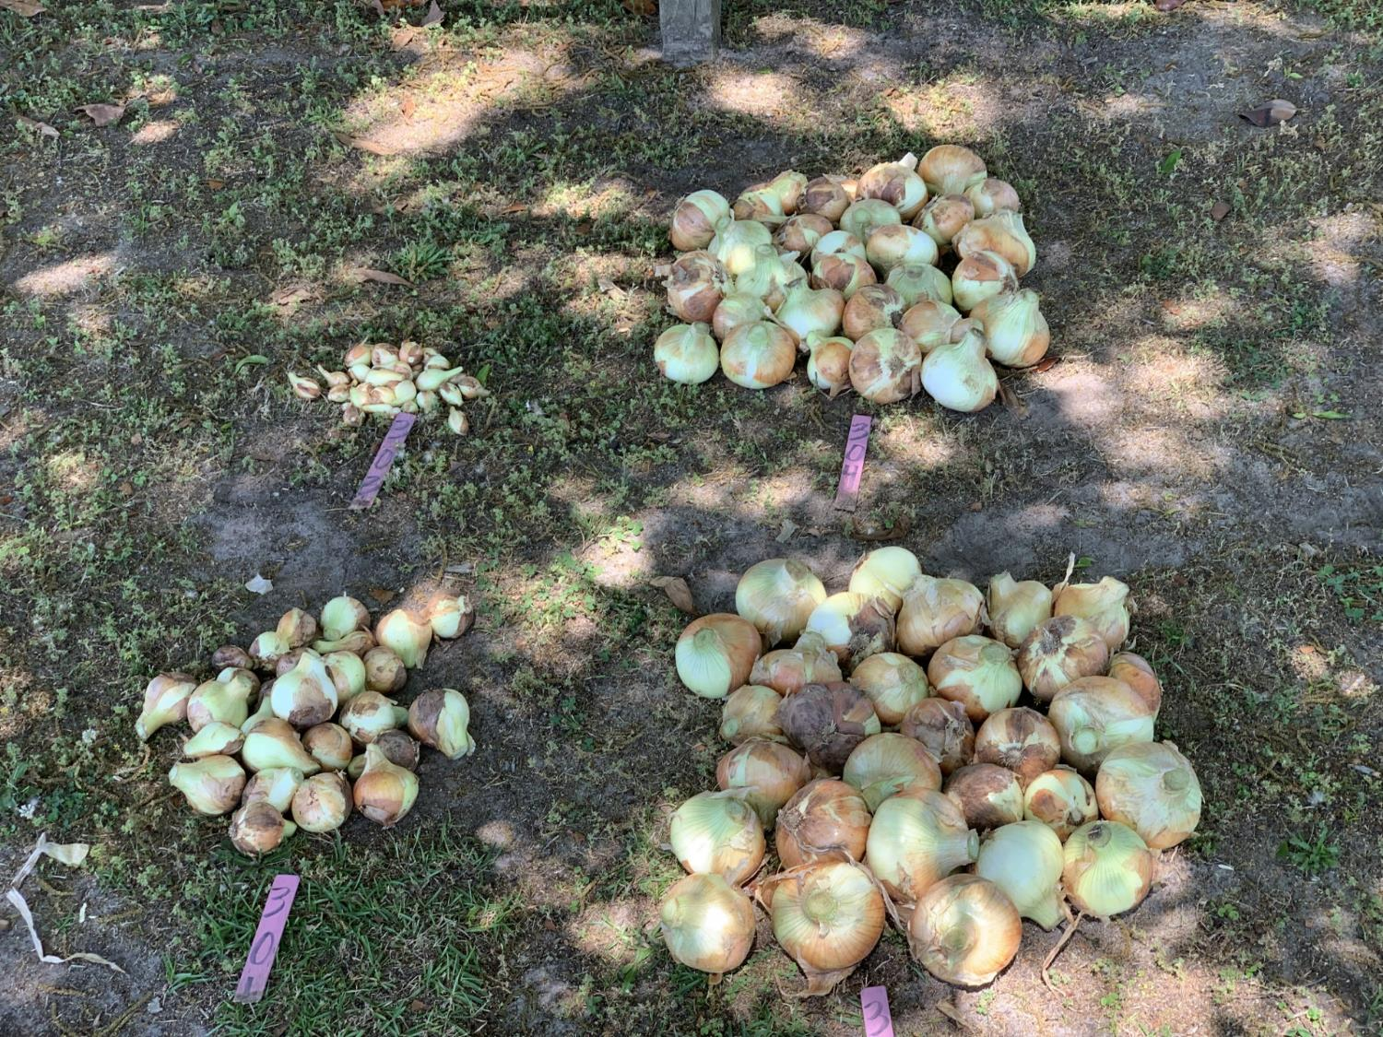
Onions Per Plot – Seeded Laser Weeder Exp. 2024
Laser weeder
No weed control
Herbicide program
Laser weeder
+
Herbicide program

Slide 20
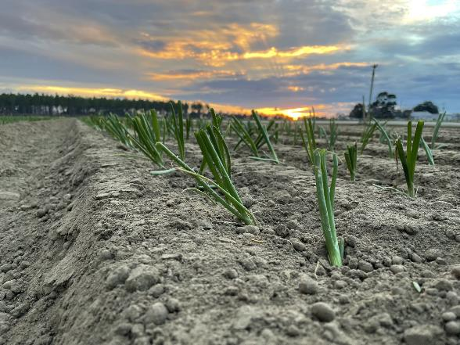
Transplant Onion Experiment – Planted Nov 16
1. No weed control
2. LaserWeeder Dec 5, Jan 3, Feb 27, Mar 21
3. Herbicide program
4. Herbicide program + LaserWeeder
Photo = Chris Tyson
Herbicide Program
Prowl 2 pt – 2 days after transplant
Goal XL 2 pt - 2 days after transplant
Notes:
Good even

Slide 21
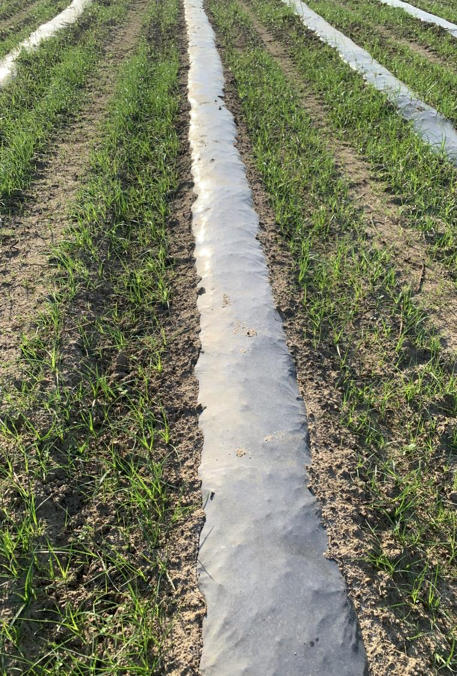
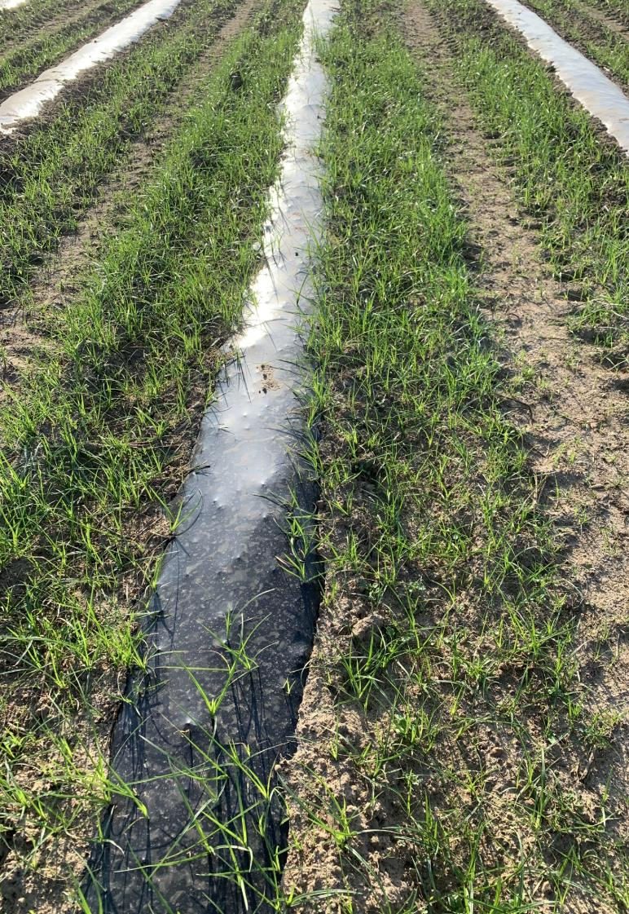
“Paper” vs. Standard LDPE Mulch on Nutsedge
Herbicide removal
Nutsedge control
John Bennet (watermelon session)
LDPE
“Paper”

Slide 22
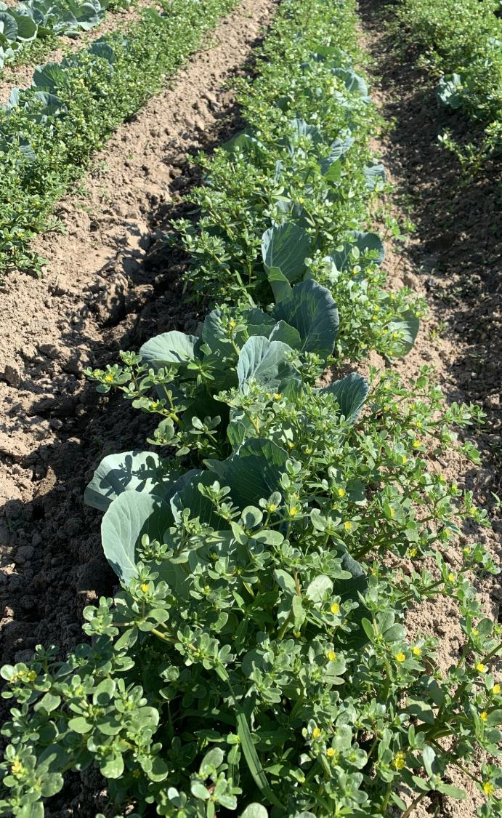
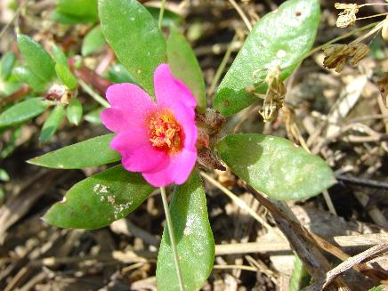
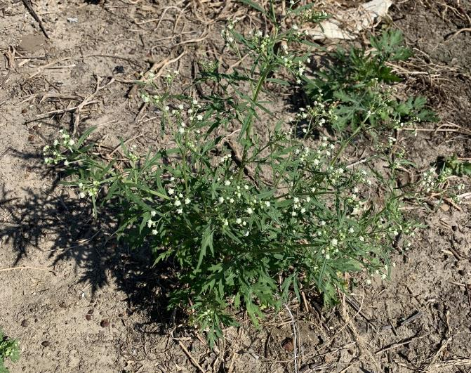
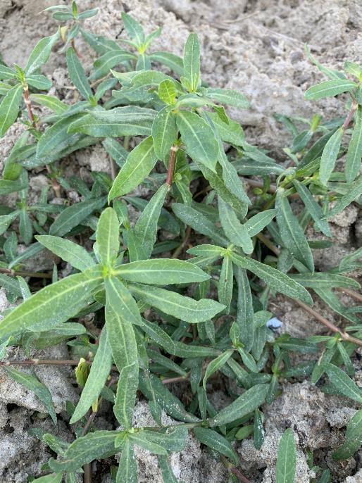
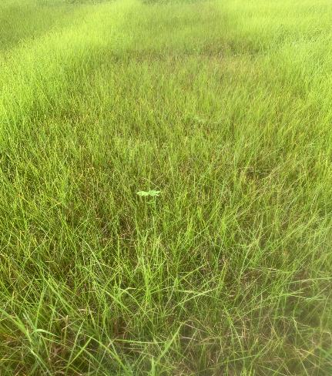
Common purslane
Ragweed parthenium
Pink purslane
Nutsedge
Alligator weed

Slide 23

Residual herbicides are key……if activated
Atrazine
Chateau
Devrinol
Dual Mag
Goal
Outlook
Prowl
Reflex
Sencor
Sonalan
Sencor
Treflan
Valor

Slide 24

Potentially Effective Postemergence Materials
Atrazine
Lorox
Sencor
Roundup fb Gramoxone*
Roundup fb Liberty*
1. Residual herbicides are key in crop.
2. *Between Crops: Max Roundup allowable followed by Gramoxone or Liberty 5 to 7 d later.

Slide 25
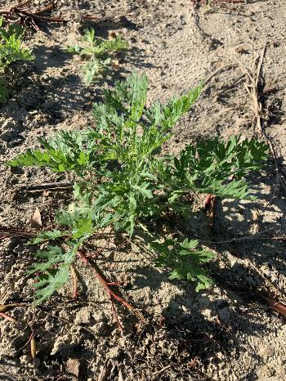
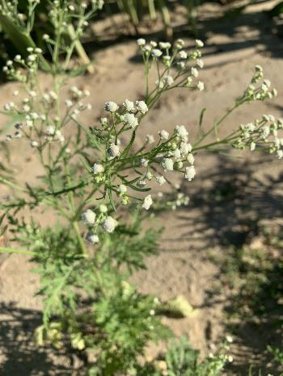
Ragweed Parthenium – Generating Data
Liberty (full rate): very good
Roundup: very bad on ours
Roundup + dicamba: excellent
Roundup + 2,4-D: fair
Command PRE: very good
Valor/Chateau PRE: fair/good
RU + 2,4D
RU + dicamba
RU + 2,4D
RU + dicamba
RU + 2,4D
RU + dicamba
4”
7”
10”
Ragweed Parthenium Size

Slide 26

Ragweed Parthenium – Data is Still Limited
Liberty (full rate): very good
Roundup: very bad on ours
Roundup + dicamba: excellent
Roundup + 2,4-D: fair
Command PRE: very good
Valor/Chateau PRE: fair/good
From Literature
Dual: poor
Prowl/Treflan: poor
Gramoxone: poor
Basagran: poor
Atrazine: poor

Slide 27
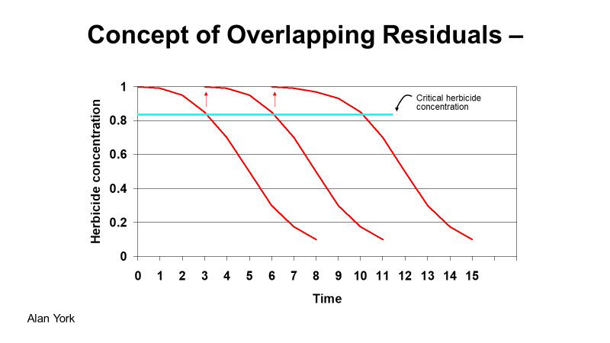
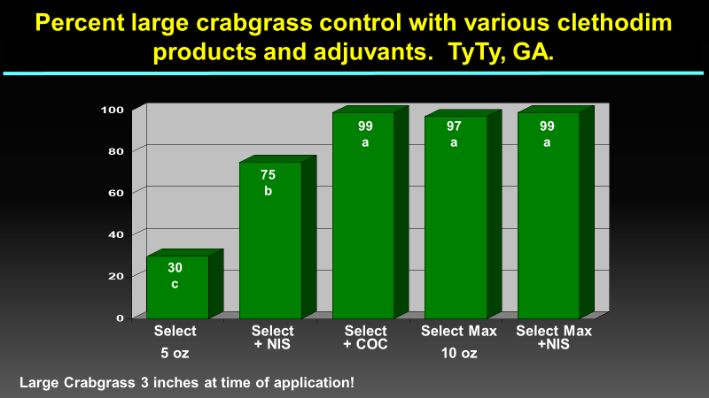
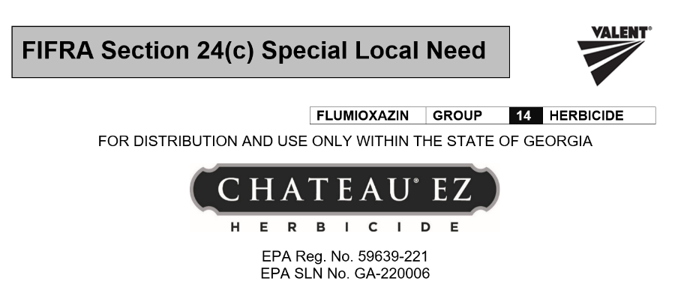
Four Areas To Consider For Huge Payoff!
Hooded Sprayer!

Slide 28
If feasible, apply two residuals, both effective on your major pest, together!
# pigweed per acre at 21 days
55,510
39,650
26,840
4270
2440
4575
Reflex
12 oz
Direx
16 oz
Warrant
48 oz
Reflex
+
Direx
Reflex
+
Warrant
Direx
+
Warrant
NT = 1,464,000 per acre; LSD 21 K; C10 2014

Slide 29







Science, Cooperation, & Communication
Farmers
Industry Partners

